Slide 1
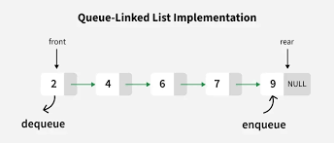
Problem Statement: The "Code-a-Thon" T-Shirt Queue
bool RemoveStudentById(int Id) {// tick
if (head == nullptr) {
cout << "queue is empty.\n";
return false;
}
Node* temp = head;
if (head->id == Id) {//start
head = head->next;
delete temp;
return true;
}
while (temp->next && (temp->next)->id != Id) {
temp = temp->next;
}
if (temp->next == nullptr) {
cout << "ID not found.\n";
return false;
}
Node* cur = temp->next;
temp->next = cur->next;
if (cur == tail) {
tail = temp;
}
delete cur;
return true;
}
void DisplayQueue() const {// tick
Node* cur = head;
cout << "Displaying Queue:\n";
while (cur) {
cout << cur->name << " : " << cur->id << endl;
cur = cur->next;
}
}
Start the program and create an empty queue for students.
Each student has:
A name
A unique ID
A link to the next student (to form a chain).
Main menu options:
Add Student: Ask for the student’s name and ID. Add them to the end of the queue.
Serve Student: The first student in the queue gets their T-shirt. Remove them from the front of the queue. If no one is waiting, show “Queue is empty”.
Student Leaves: Ask for a student’s ID. Find and remove that student from any position in the queue. If the ID is not found, show “ID not found”.
Display Queue: Show the list of students from front to back, with their names and IDs.
Count Students: Count how many students are currently in the queue and display the total.
The menu repeats until the user chooses to Exit.
End the program and show total execution time (how long the program ran).
head
tail
Serve student
Add Student

